Slide 1

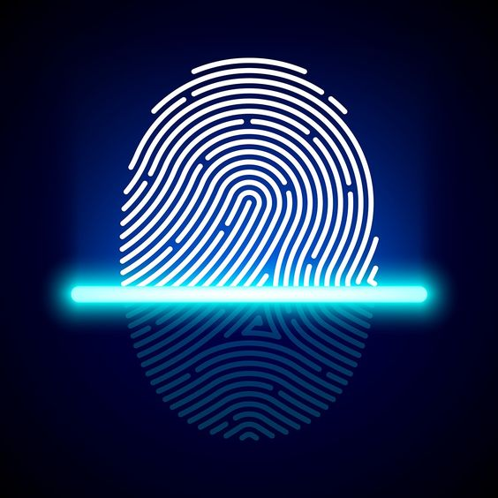

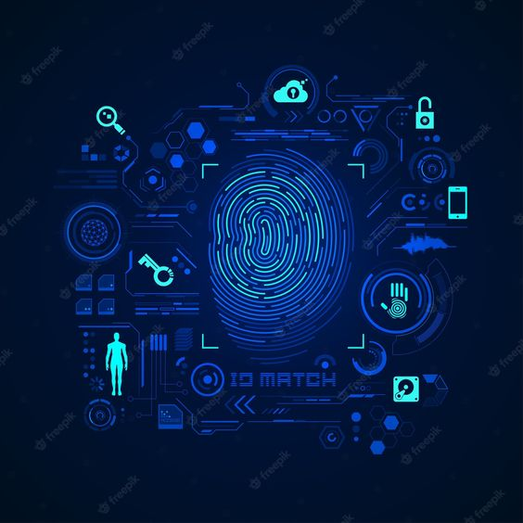
FINGERPRINT
RECONSTRUCTION
DONE BY:
AADITHYA.S ,JAGAJANANI.S.D ,NIVETHA.A
SRI SAIRAM INSTITUTE OF TECHNOLOGY

Slide 2
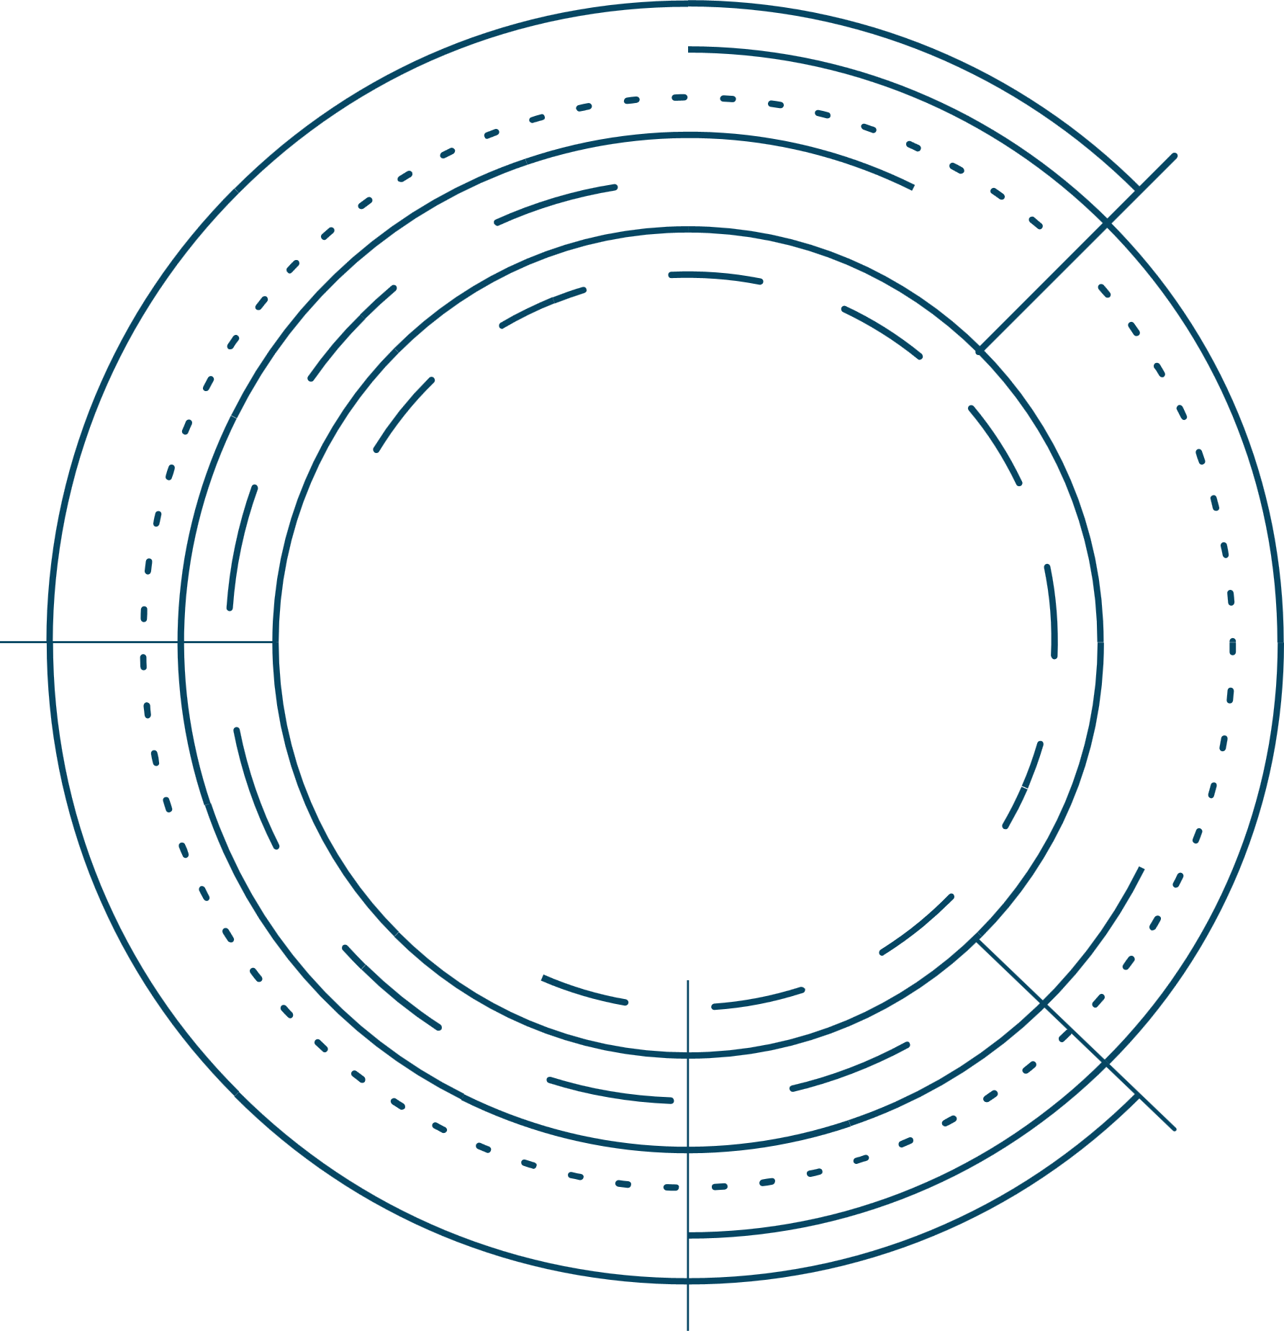
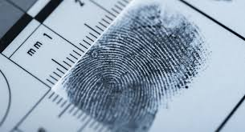
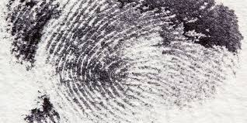
INTRODUCTION
This study investigates the potential of deep learning techniques for reconstructing partial fingerprints, which poses a challenge in forensic identification within today's fast-paced world.
The focus lies on prominent approach of Generative Adversarial Networks and Variational Autoencoders. The analysis considers various factors such as dataset size, computational resources, and reconstruction complexity.
This comprehensive overview sheds light on the promise of deep learning in fingerprint reconstruction and outlines ongoing research directions in this evolving field.

Slide 3




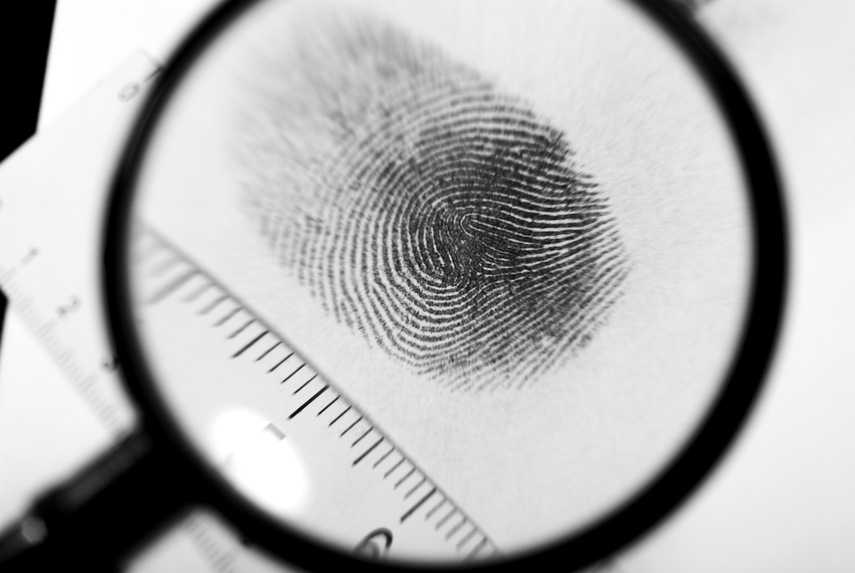

PROBLEM STATEMENT
Distorted
Requisites
Objective
The current landscape of fingerprint reconstruction presents significant challenges including incomplete or distorted images and reliance on manual intervention which hinder forensic analysis and efficient criminal investigations.
The primary objective is to propose and develop advanced AI-solutions that not only enhance accuracy but also streamline the process, ultimately empowering law enforcements with reliable tools for forensic analysis .
To overcome these obstacles, there is a critical need for innovative approaches that integrate emerging technologies such as machine learning, computer vision, and pattern recognition.

Slide 4
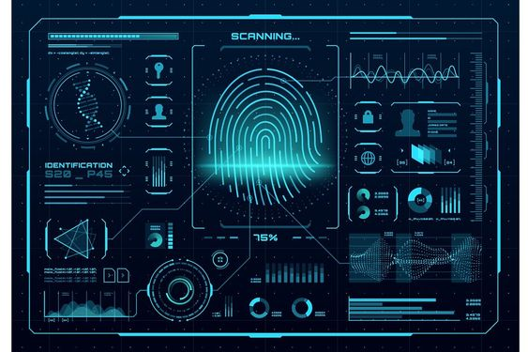
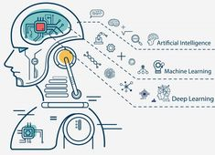
THEORIES
Law enforcement incorporates a deep learning model specifically trained for reconstructing complex partial fingerprints.
The model analyzes the partial fingerprint, leveraging its knowledge of fingerprint patterns and smudge patterns learned from a massive training dataset.
The model attempts to "inpaint" the missing regions and reconstruct a more complete fingerprint image.
Variational Inference: This theory provides a probabilistic approach to learning latent representations of data. In AVAEs, the VAE component utilizes variational inference to encode a partial fingerprint into a latent space, capturing the essential features for reconstruction.

Slide 5
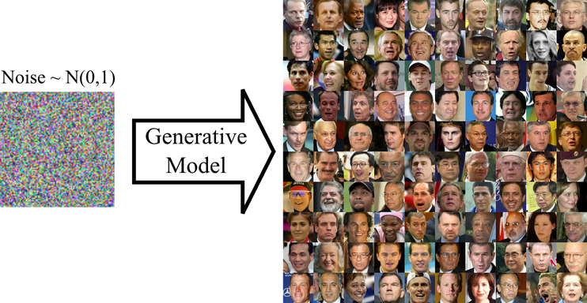
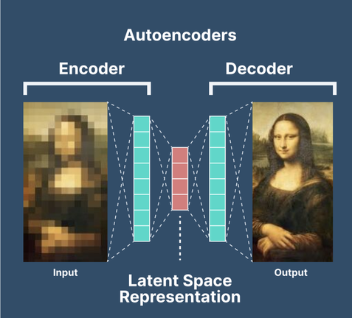
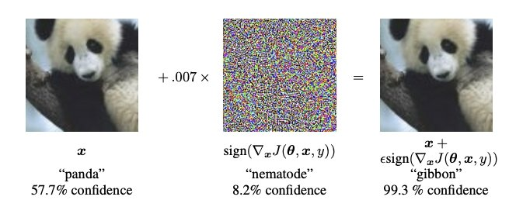
THEORIES
Generative Modeling: This theory focuses on algorithms that can learn the underlying distribution of data and generate new samples that resemble the training data. In AVAEs, the GAN component leverages generative modeling principles to create realistic and detailed reconstructions of complete fingerprints from the latent representation.
Autoencoders: This is a type of artificial neural network architecture that learns to compress input data into a latent representation and then reconstruct the original data from that compressed code. In AVAEs, the encoder-decoder structure is based on autoencoder principles, allowing the model to learn compressed representations of partial fingerprints suitable for reconstruction.
Adversarial Learning: This theory is based on training two models competitively. In AVAEs, the GAN component utilizes adversarial learning where the generator creates reconstructions, and the discriminator tries to distinguish them from real fingerprints. This competition pushes the generator to produce more realistic outputs.

Slide 6
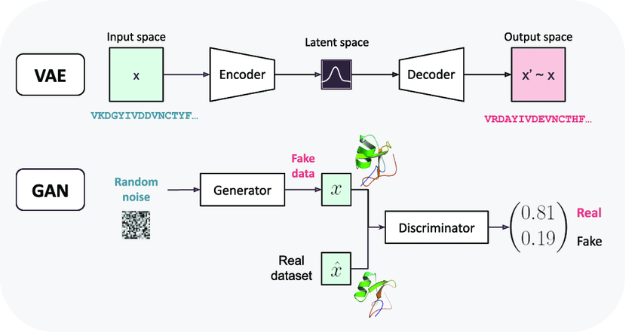
AVAE
Two families of generative models stand out for image data: Variational Autoencoders (VAE) and Generative Adversarial Networks (GAN) , each exhibiting respective advantages and limitations.
GANs usually produce more realistic images but they are notoriously difficult to train and suffer from mode collapse.
In contrast, VAE models do not share these problems but the images they generate suffer from a lack of realism. It is often explained by the use of inappropriate reconstruction errors.
To solve this issue a new framework has been introduced that combines VAE and GAN in a novel and complementary way to produce an auto-encoding model that keeps VAEs properties while generating images of GAN-quality.

Slide 7
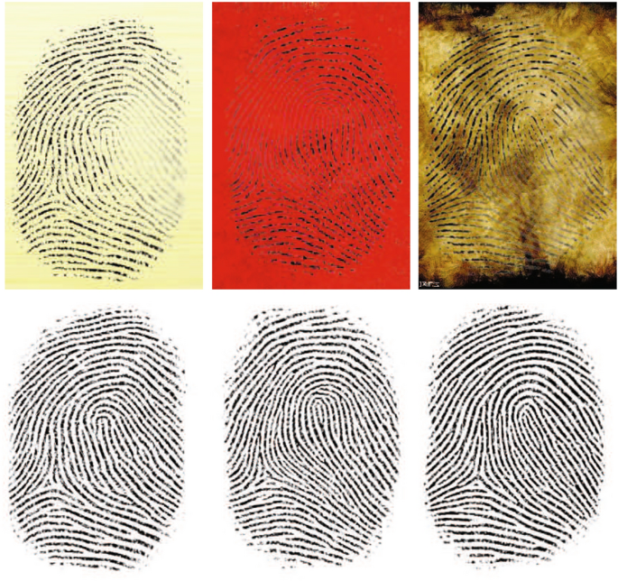
AVAE
AVAE is a novel framework that combines VAE and GAN.
It produces an auto-encoding model that retains VAE properties while generating images of GAN-quality.
By addressing the dimensionality issue, AVAE bridges the gap between realism and latent representation.
AVAE has applications in various fields, including:
Computer Vision: Generating realistic images.
Artificial Intelligence: Enhancing creativity and content generation.

Slide 8
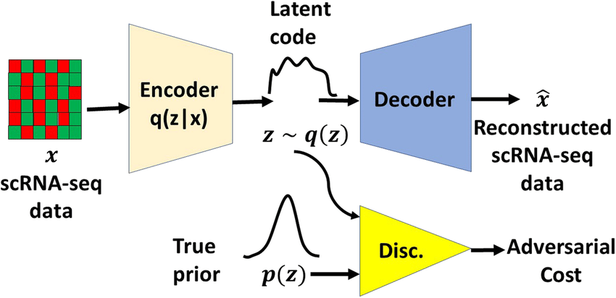
ARCHITECTURE

Slide 9
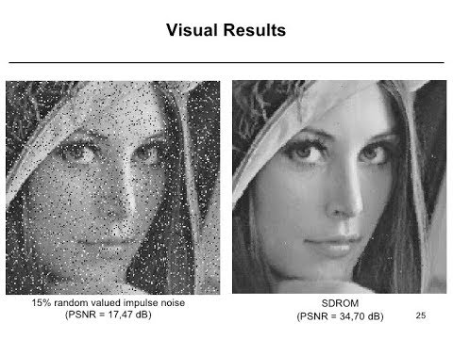
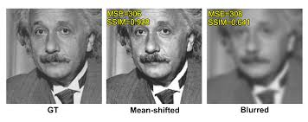
RESULTS & DISCUSSIONS
Quote statistics based on simulated PERFORMANCE METRICS to showcase the effectiveness of the AVAE.
PSNR (Peak Signal-to-Noise Ratio)
SSIM (Structural Similarity Index Measure)

Slide 10
RESULTS & DISCUSSIONS
COMPARISON WITH OTHER APPROACHES
Stacked Autoencoders:
Stacked autoencoders might be a simpler alternative for less complex partial prints. However, they might struggle with intricate details and require careful architecture design to achieve good performance.
Traditional Fingerprint Reconstruction Techniques:
Traditional methods might not be as effective in handling highly damaged or complex partial prints. AVAEs offer the potential for more robust reconstruction under challenging conditions.

Slide 11
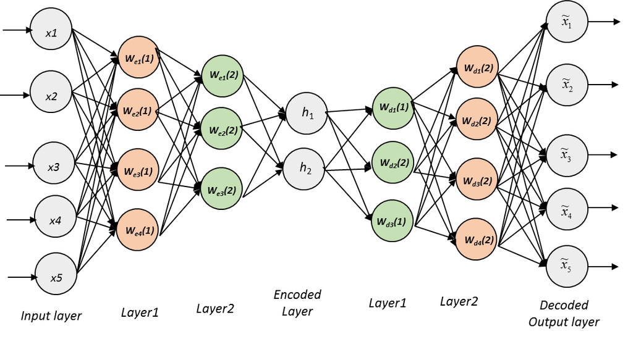
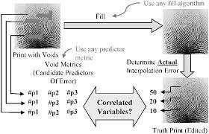
RESULTS & DISCUSSIONS
STACKED AUTO ENCODERS
TRADITIONAL METHOD
IMAGE SEGMENTATION

Slide 12
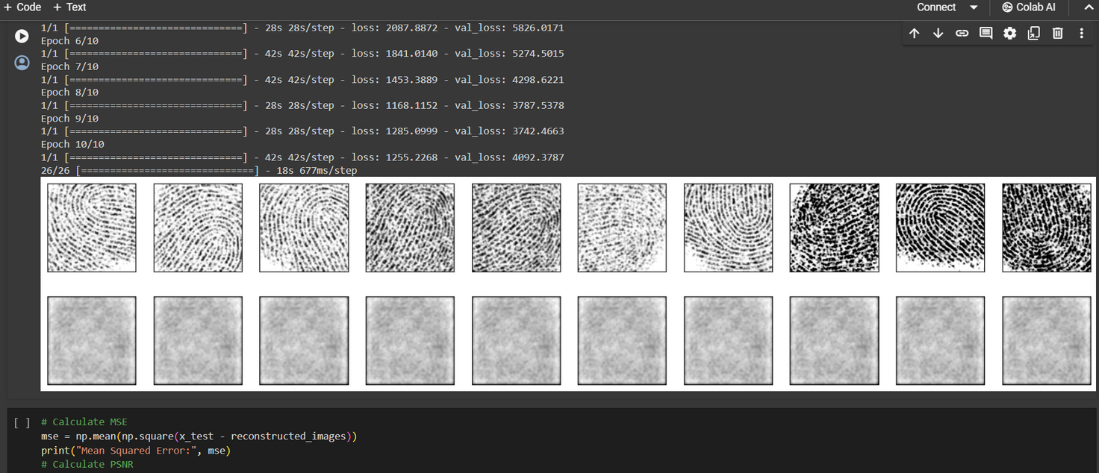
RESULTS & CONCLUSION
AVAE successfully reconstructs complex partial fingerprints, filling in missing regions and generating realistic details, even for those with smudging or other imperfections (similar to the one in the image).
The model has the ability to handle variations that might challenge traditional fingerprint identification methods.
For 10 epochs
Model’s MSE : 0.252
Model’s PSNR : 54.104

Slide 13
REFERENCES
Striuk, Oleksandr, and Yuriy Kondratenko. "Adaptive deep convolutional GAN for fingerprint sample synthesis." 2021 IEEE 4th International Conference on Advanced Information and Communication Technologies (AICT). IEEE, 2021.
[1]
[2]
Saponara, Sergio, Abdussalam Elhanashi, and Qinghe Zheng. "Recreating fingerprint images by convolutional neural network autoencoder architecture." IEEE Access 9 (2021).
Ding, Baojin, et al. "End-to-end surface and internal fingerprint reconstruction from optical coherence tomography based on contour regression." IEEE Transactions on Information Forensics and Security 18 (2022).
[3]
[4]
Cui, Zhe, Jianjiang Feng, and Jie Zhou. "Monocular 3D fingerprint reconstruction and unwarping." IEEE Transactions on Pattern Analysis and Machine Intelligence (2023).
Makrushin, Andrey, Venkata Srinath Mannam, and Jana Dittmann. "Data-Driven Fingerprint Reconstruction from Minutiae Based on Real and Synthetic Training Data." VISIGRAPP (4: VISAPP). 2023.
[5]

Slide 14

“Values are like fingerprints. Nobody’s are the same, but you leave 'em all over everything you do.” – Elvis Presley
THANK YOU

